Slide 1
Bioinformatics

Slide 2
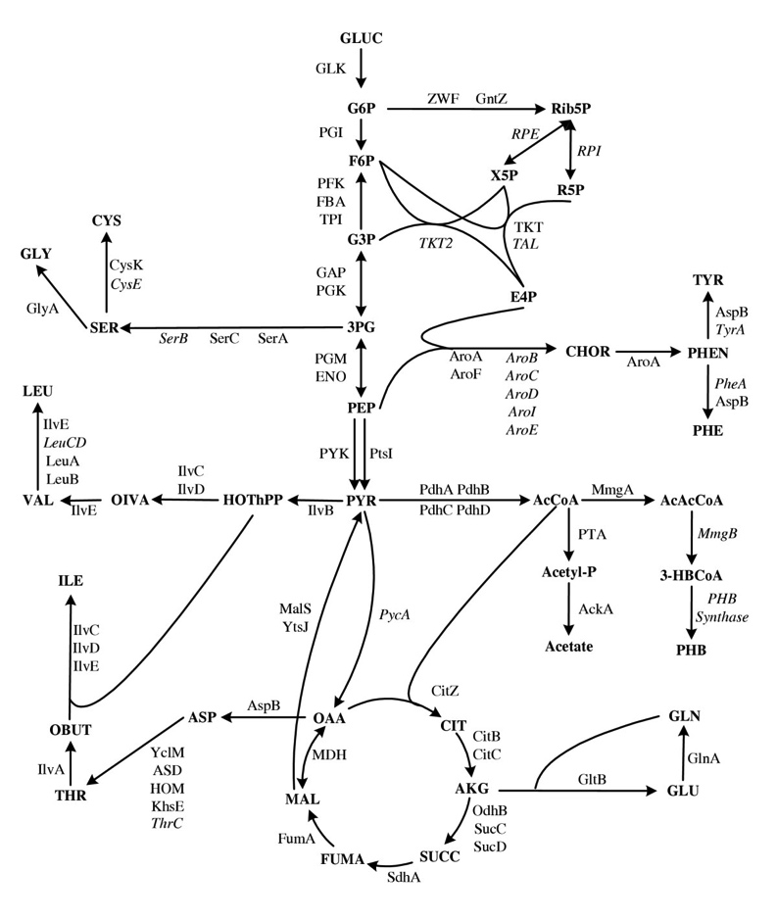
The spandrels of San Marco and the Panglossian Paradigm
Notes:
Enormous amount of information – the problem just got much more complex
Gould and Lewontin: Long been a question of what the purpose of different features are
In evolutionary biology, a spandrel is a phenotypic characteristic that is a byproduct of the evolution of some other characteristic, rather than a direct product of adaptive selection.

Slide 3
Outline
Overview of genomic annotation
Identifying the causal variant
Intro to online resources
Functional annotation and pathway enrichment

Slide 4
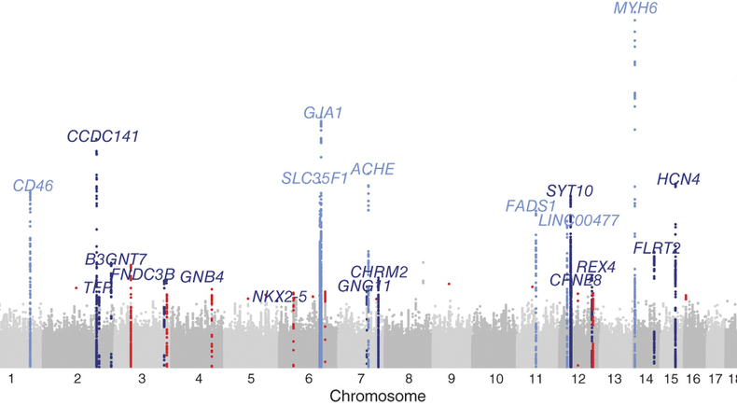
For every complex problem there is a solution which is simple, neat, and wrong - H.L. Mencken
Notes:
The tiny perturbation of a DNA sequence leads to contribution of disease decades into the future
Posing how this happens in deterministic terms is extremely hard
How do you know which is the causal variant?

Slide 5
Quick tour of the UCSC genome browser
Notes:
Genic features
Annotations
SNPs that have previously been identified in GWAS
Reported mRNA
DNase1 hypersensitivity
Evolutionary conservation
Comparison to other animals
Variants

Slide 6
Why is fine mapping hard?
Loos and Yeo 2014

Slide 7
Why is fine mapping hard?
Faye et al 2013 (Plos Genetics):
Localization success rate decreases as the correlation between the tag and causal SNP increases.
Study selection at the tag SNP exacerbates this problem by increasing the magnitude of the association evidence at the tag SNP itself and at other neighboring SNPs in higher LD with the tag relative to the causal SNP.
Differential genotyping or imputation error between SNPs further decreases localization success rate, with or without the tag selection.
This problem can be exacerbated by increasing sample size, if genotyping accuracy at the causal SNP is lower than at neighboring SNPs.
Notes:
Second point – if we take the tag SNP from study one forward we might

Slide 8
FTO example
UCSC shows how heavily studied this locus is
Discovered as a SNP influencing T2D in 2007
But this signal completely disappeared after adjusting for BMI
In Europeans explains 0.3% of phenotypic variance
Many variants identified independently in 46kb region of first intron
FTO: “RNA demethylase that links amino acid availability and mTORC1 signalling to regulate growth and mRNA translation”

Slide 9
FTO example
Conditional analysis only finds one SNP in the region
Can look at association in different populations to help narrow down the search
103 candidate SNPs in European populations
29 in African populations
6 are in introns…
2 predicted to influence transcription binding…

Slide 10
How does FTO influence obsesity?
Prevailing hypotheses:
Changes food intake behaviour
High expression in brain
Mice with overexpression eat more
Changes in physical activity
The effect of FTO is severely attenuated amongst physically active
But FTO variant doesn’t seem to influence physical activity directly
But this is difficult to measure
Causes transcription regulation of downstream gene which influences metabolism

Slide 11
TNFAIP3 example
Adrianto 2011 NG: Association of a functional variant downstream of TNFAIP3 with systemic lupus erythematosus
Top hit the same in Koreans and other Asians
Different in Europeans

Slide 12
TNFAIP3 – Lab work
Candidate variant (TT>A) examined in cell lines
Causes weaker binding with NF-kb complex
Results in reduced transcription of TNFAIP3
Reduced A20 protein abundance
Is this enough to declare causality for Lupus?

Slide 13
Multiple sclerosis
IFI30
Missense mutation of lysosomal enzyme that processes antigens for MHC presentation
MPV17L2
No known immune function
Fahr et al 2015

Slide 14
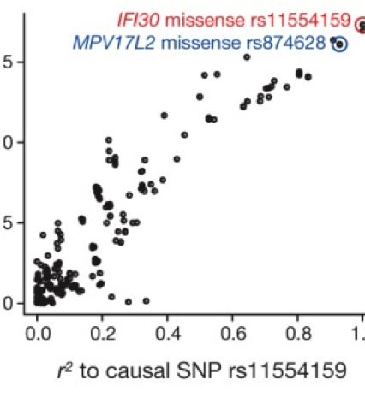
Probabilistic Identification of Causal SNPs (PICS) method
If rs11554159 is real causal variant then –log10(p) value of all other SNPs should reduce linearly as their correlation with the SNP reduces

Slide 15
Minimise number of candidate SNPs

Slide 16
Use functional annotation to reduce number of candidate SNPs

Slide 17
Enrichment analysis
Perhaps more useful to take lots of candidate genes and see if they have something in common
Use databases and functional annotations of genes to categorise and classify them
Generate a statistic that tests how enriched the candidate genes are for a particular list of features

Slide 18
Gene Ontology (GO) terms
Maintain and develop a controlled vocabulary of gene and gene product attributes
cellular component, the parts of a cell or its extracellular environment;
molecular function, the elemental activities of a gene product at the molecular level, such as binding or catalysis;
biological process, operations or sets of molecular events with a defined beginning and end, pertinent to the functioning of integrated living units: cells, tissues, organs, and organisms.
Notes:
This is not always reliable! Work in progress. Anecdote about genes with immune function names being implicated in brain disease now…

Slide 19
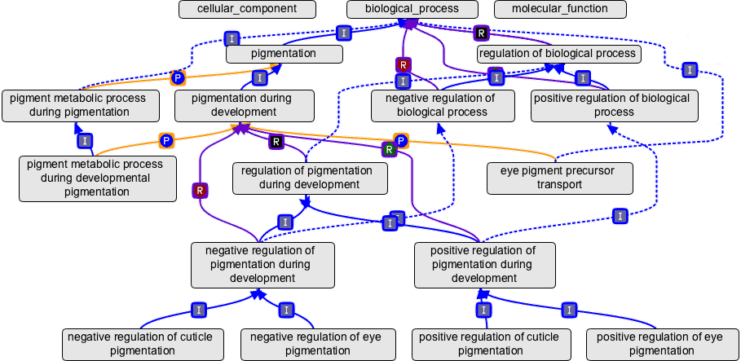
Gene Ontology (GO) terms
E.g. A gene could be annotated with no GO terms or many go terms depending on what information is available for it
Thousands of GO terms exist, e.g.

Slide 20
Kyoto Encyclopedia of Genes and Genomes (KEGG)
Systems information
PATHWAY — pathway maps for cellular and organismal functions
MODULE — modules or functional units of genes
BRITE — hierarchical classifications of biological entities
Genomic information
GENOME — complete genomes
GENES — genes and proteins in the complete genomes
ORTHOLOGY — ortholog groups of genes in the complete genomes
Chemical information
COMPOUND, GLYCAN — chemical compounds and glycans
REACTION, RPAIR, RCLASS — chemical reactions
ENZYME — enzyme nomenclature
Health information
DISEASE — human diseases
DRUG — approved drugs
ENVIRON — crude drugs and health-related substances
Notes:
This is not always reliable! Work in progress. Anecdote about genes with immune function names being implicated in brain disease now…

Slide 21
Annotation
Gene name
Gene function
GO terms
KEGG pathways
Transcription factor binding sites
Regulatory regions
Gene expression levels
Tissue specific expression
DNA conservation
Etc etc etc etc

Slide 22
Suppose I have a list of genes…
…that were obtained from a GWAS. I annotate them with some terms from GO or KEGG or anything else. How do I know if they are enriched for a particular function?
Could simply count which terms come up most frequently in my list.
Why might I be wrong to use this metric?

Slide 23
Why might I be wrong?
Some terms might be more common than others
Chance of picking up large genes is higher than small genes
If chance of detection is higher for genes with higher LD then this might be associated with functional annotation
Allele frequency could be related to annotations (esp to do with selection) and more intermediate frequencies are easier to detect
There could be ascertainment bias on the SNP chip
Etc etc
Very important to have an appropriate null hypothesis

Slide 24
How many human genes
1990: estimate human genes ~300,000
1995: estimate human genes ~100,000
2000: estimate human genes ~30,000
2004: estimate human genes ~25,000
2008: estimate human genes ~22,000
2009: known human genes: 18,308
How can complexity be generated by so few genes?
REGULATION
Notes:
Regulation may be quite important

Slide 25
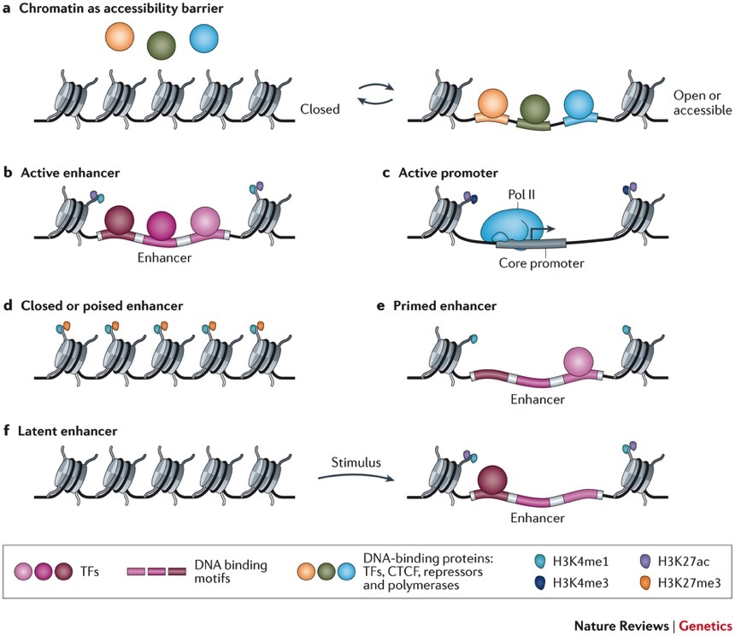
Epigenetics - chromatin

Slide 26
Chromatin marks in ENCODE
Large number of cell types
Measure the chromatin states for each cell type right across the genome
Characterise each cell type by its patterns of chromatin
Highly predictive of cell type and relationships between different cell types

Slide 27
Trynka 2012 NG
Hypothesis: SNPs influencing disease will be in regions influencing gene regulation by altering regulatory elements in cell types most relevant to the disease.
Analysis: Look to see if there is an enrichment of SNPs in the regulatory regions of relevant tissues

Slide 28
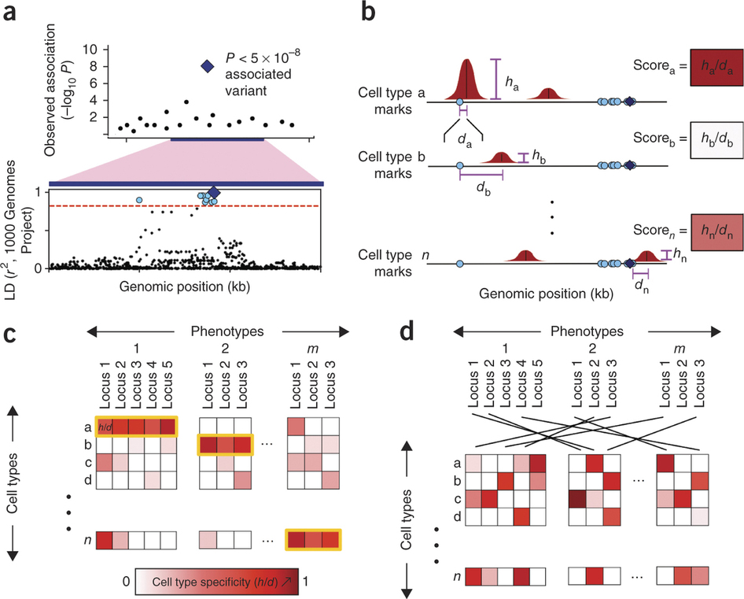
Trynka 2012 NG

Slide 29
Farh et al Nature

Slide 30
Summary
Going from GWAS signal to causal variant is often very difficult
Can use different populations
Functional annotation
Lab work
Enrichment analysis can provide insight into disease mechanisms
But must be careful to avoid false positives
Huge amount of data being generated to annotate genomes
Countless hypotheses can be generated and tested
The quality of the data is quite variable

Slide 31
Functional annotation
http://kn3in.github.io/annotation/ - good tutorial on using biomart in R
Haploreg http://www.broadinstitute.org/mammals/haploreg/haploreg_v3.php
Ensembl http://www.ensembl.org/info/docs/tools/vep/index.html

Slide 32
Databases
Broad Spectrum Queries
Entrez
http://www.ncbi.nlm.nih.gov/sites
GeneCards
http://www.genecards.org/
Nucleotide
GenBank
http://www.ncbi.nlm.nih.gov/Genbank
Ensembl
http://www.ensembl.org/
Mutation
HGMD (Human gene mutation database)
http://www.hgmd.cf.ac.uk
Database of Genomic Variants:
http://projects.tcag.ca/variation/
mutDB:
http://www.mutdb.org/
Mitomap (Mitochondrial DNA):
http://www.mitomap.org/
SNPs & common structural changes
1000 genomes
http://www.1000genomes.org/
ALFRED
http://alfred.med.yale.edu/alfred/index.asp
UCSC genome browser
http://genome.ucsc.edu/
dbSNP
http://www.ncbi.nlm.nih.gov/projects/SNP/
HapMap
http://hapmap.ncbi.nlm.nih.gov/

Slide 33
Databases
Genomewide association study results
Catalogue of human genomewide association studies
http://www.genome.gov/gwastudies/
Expression
NCBI
http://www.ncbi.nlm.nih.gov/
Jackson mouse laboratories
http://phenome.jax.org/
UCSC genome browser
http://genome.ucsc.edu/
Regulatory elements (miRNA)
Noncoding RNA database
http://biobases.ibch.poznan.pl/ncRNA/
The Rfam data base, Sanger
http://rfam.sanger.ac.uk/
Bioexplorer.net
http://www.bioexplorer.net/Databases/
Protein
UniProt
http://beta.uniprot.org/
PDB (Protein Data Bank)
http://www.pdb.org/pdb/home/home.do
PIR (Protein Information Resource)
http://pir.georgetown.edu/
Pfam (protein families - Sanger)
http://pfam.sanger.ac.uk/
HMPD (Human mitochondrial protein database)
http://bioinfo.nist.gov/
Linkage disequilibrium
SNAP annotation and proxy search
http://www.broadinstitute.org/mpg/snap/

